Slide 1
Spatiotemporal Data Management and Analytics Spatial Query Processing 2
By Prof Xiaofang Zhou, Dr Lei Li and Dr Pingfu Chao
University of Queensland

Slide 2
Learning Modules
 | Date | Lecture | Lecturer
1 | 22/6 | Course Introduction and RDBMS Review | Prof Xiaofang Zhou
2 | 22/6 | Introduction to Spatial Databases
3 | 23/6 | Spatial Data Organisation | Dr Lei Li
4 | 23/6 | Spatial Query Processing
5 | 24/6 | Managing Spatiotemporal Data | Dr Pingfu Chao
6 | 24/6 | Managing High Dimensional Data | Dr Lei Li
 | 25/6 | 端午节
7 | 26/6 | Advanced Topic: Route Planning in Road Networks | Dr Lei Li
8 | 26/6 | Future Trends, Course Review and Discussions | All
 |  | Revision Period
 | 9 July | Final Report Due

Slide 3
Recommended Readings
Nick Roussopoulos, Stephen Kelley and Frederic Vincent, Nearest Neighbour Queries, SIGMOD’95
Stephan Börzsönyi, Donald Kossmann, Konrad Stocker, The Skyline Operator, ICDE’01
Dimitris Papadias, Yuefei Tao, Greg Fu and Bernhard Seeger, An Optimal and Progressive Algorithm for Skyline Queries, SIGMOD’03

Slide 4
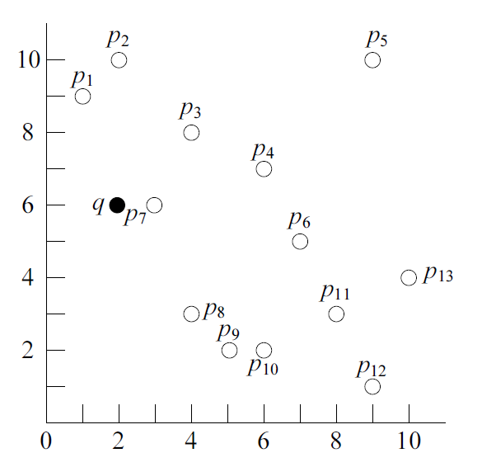
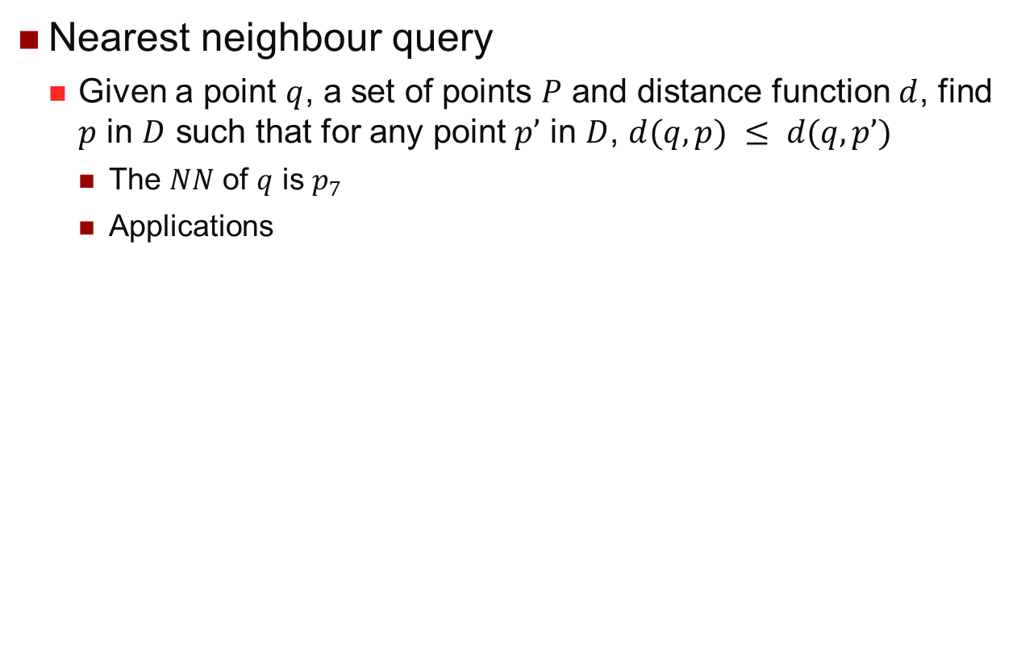
K-NN Query Processing
Nearest neighbour query
Given a point $q$, a set of points $P$ and distance function $d$, find $p$ in $D$ such that for any point $p’$ in $D$, $d(q,p) ≤ d(q, p’)$
The $NN$ of $q$ is $p_{7}$
Applications
Find the McDonald that is nearest to me
Find the customer profile in the database that is most similar to the profile of the new customer
Retrieve the image from the database that is most similar to the one given by the user

Slide 5
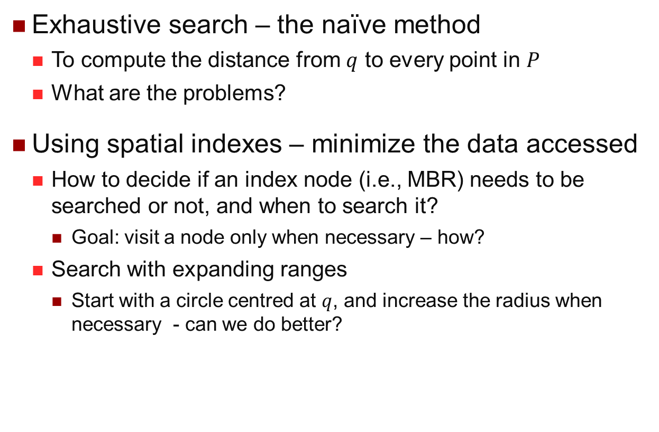
K-NN Methods
Exhaustive search – the naïve method
To compute the distance from $q$ to every point in $P$
What are the problems?
Using spatial indexes – minimize the data accessed
How to decide if an index node (i.e., MBR) needs to be searched or not, and when to search it?
Goal: visit a node only when necessary – how?
Search with expanding ranges
Start with a circle centred at $q$, and increase the radius when necessary - can we do better?

Slide 6
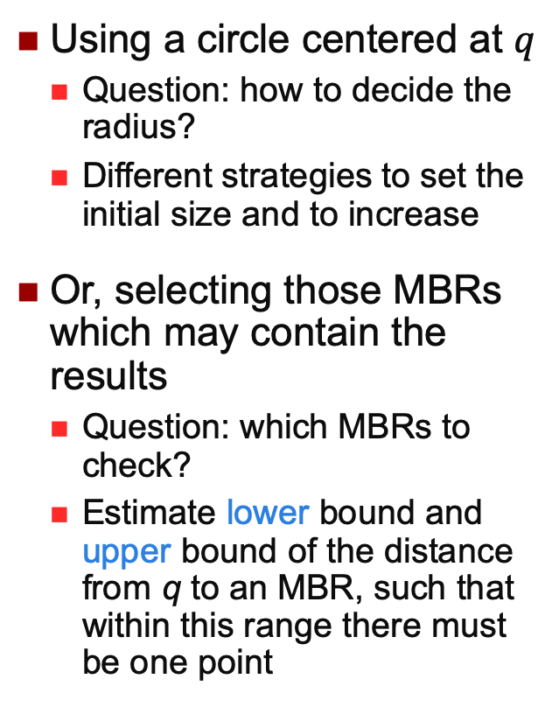
R-Tree - NN search
Using a circle centered at $q$
Question: how to decide the radius?
Different strategies to set the initial size and to increase
Or, selecting those MBRs which may contain the results
Question: which MBRs to check?
Estimate lower bound and upper bound of the distance from q to an MBR, such that within this range there must be one point
A
C
G
H
P1
B
F
P3
J
E
q
D
P2
P4
…a tight range is preferred, that is, we prefer the largest posisble lower bound and smallerest upperbound

Slide 7
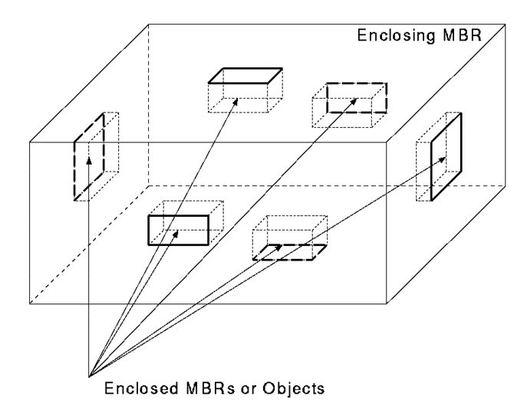
MBR Face Property
MBR is a multi-dimensional rectangle, which is the minimal rectangle that fully encloses an object or a set of objects
MBR Face Property: Every face of the MBR contains at least one point of an object in the database

Slide 8
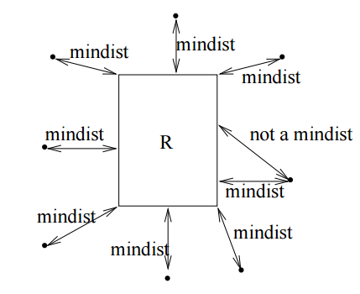
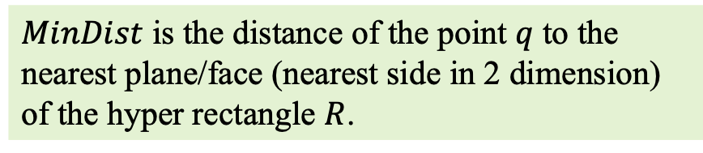
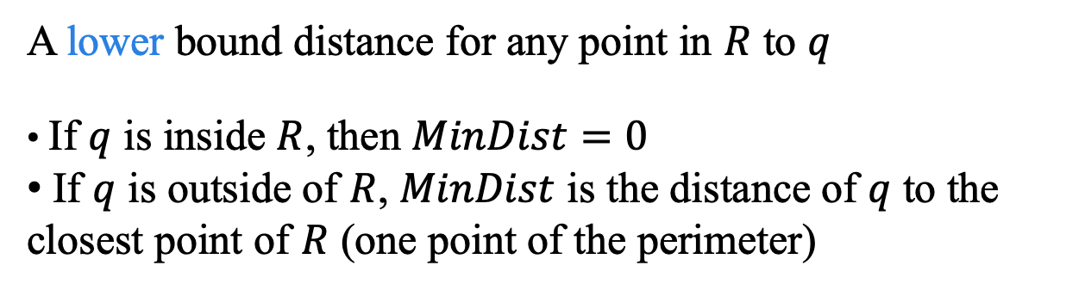
MinDist
A lower bound distance for any point in $R$ to $q$
If $q$ is inside $R$, then $MinDist=0$
If $q$ is outside of $R$, $MinDist$ is the distance of $q$ to the closest point of $R$ (one point of the perimeter)
R
R
q
R
$MinDist$ is the distance of the point $q$ to the nearest plane/face (nearest side in 2 dimension) of the hyper rectangle $R$.
…to order and prune the search in an R-tree

Slide 9
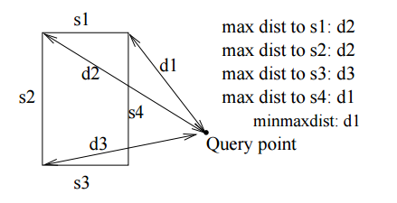
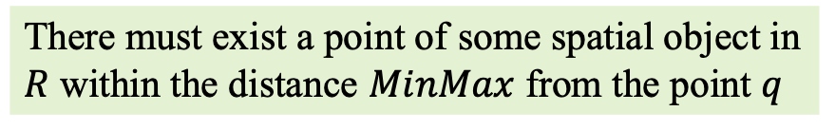
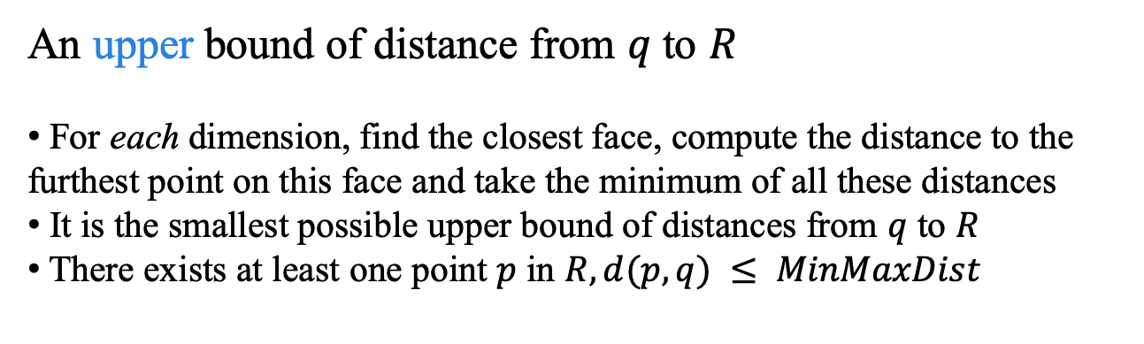
MinMaxDist
An upper bound of distance from $q$ to $R$
For each dimension, find the closest face, compute the distance to the furthest point on this face and take the minimum of all these distances
It is the smallest possible upper bound of distances from $q$ to $R$
There exists at least one point $p$ in $R, d(p, q) ≤ MinMaxDist$
MinMaxDist
q
MinDist
There must exist a point of some spatial object in $R$ within the distance $MinMax$ from the point $q$

Slide 10
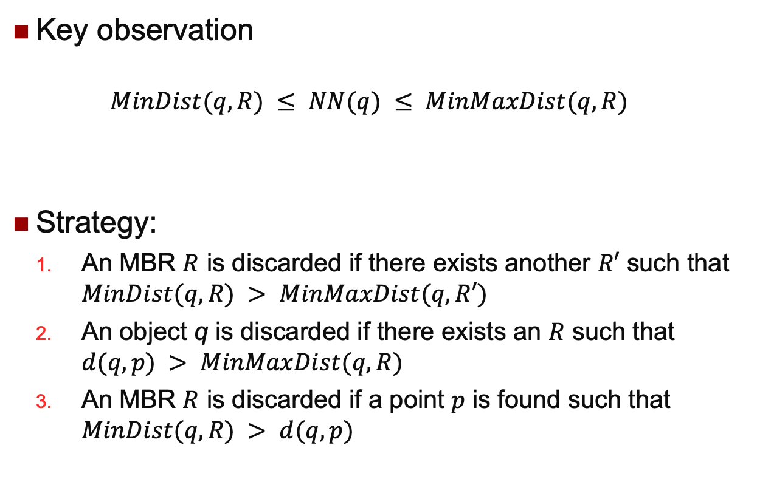
Pruning Strategies
Key observation
$$MinDist(q, R) ≤ NN(q) ≤ MinMaxDist(q, R)$$
Strategy:
An MBR $R$ is discarded if there exists another $R′$ such that $MinDist(q, R) > MinMaxDist(q, R′)$
An object q is discarded if there exists an $R$ such that $d(q, p) > MinMaxDist(q, R)$
An MBR $R$ is discarded if a point $p$ is found such that $MinDist(q, R) > d(q, p)$

Slide 11

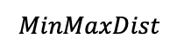
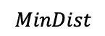
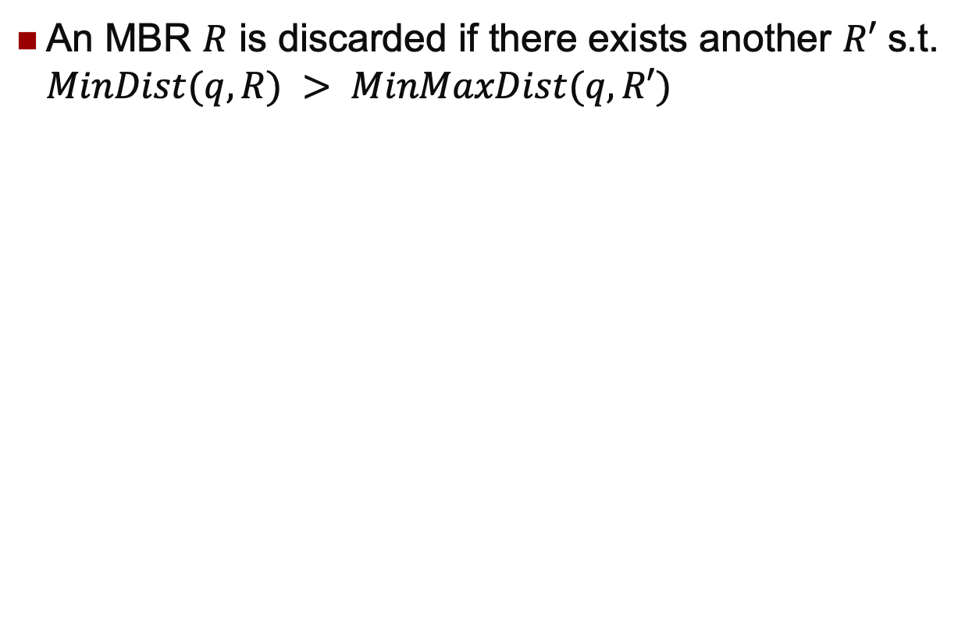
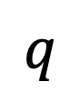
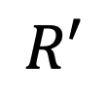
Pruning 1 Example
An MBR $R$ is discarded if there exists another $R′$ s.t. $MinDist(q, R) > MinMaxDist(q, R′)$
$$R$$
$$q$$
$$R′$$
$$MinDist$$
$$MinMaxDist$$

Slide 12
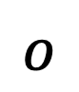
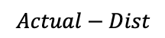
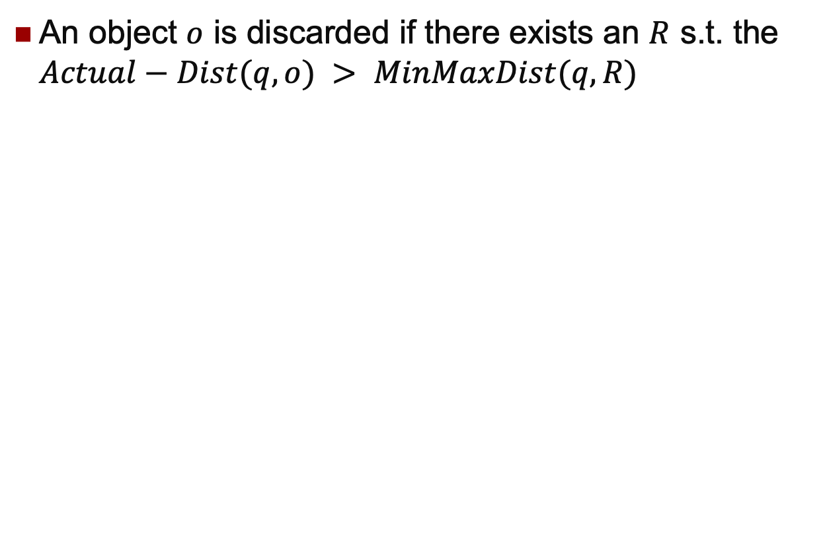
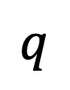

Pruning 2 Example
An object $o$ is discarded if there exists an $R$ s.t. the $Actual−Dist(q, o) > MinMaxDist(q, R)$
$$q$$
$$R$$
$$o$$
$$Actual−Dist$$
$$MinMaxDist$$

Slide 13

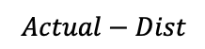
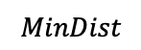
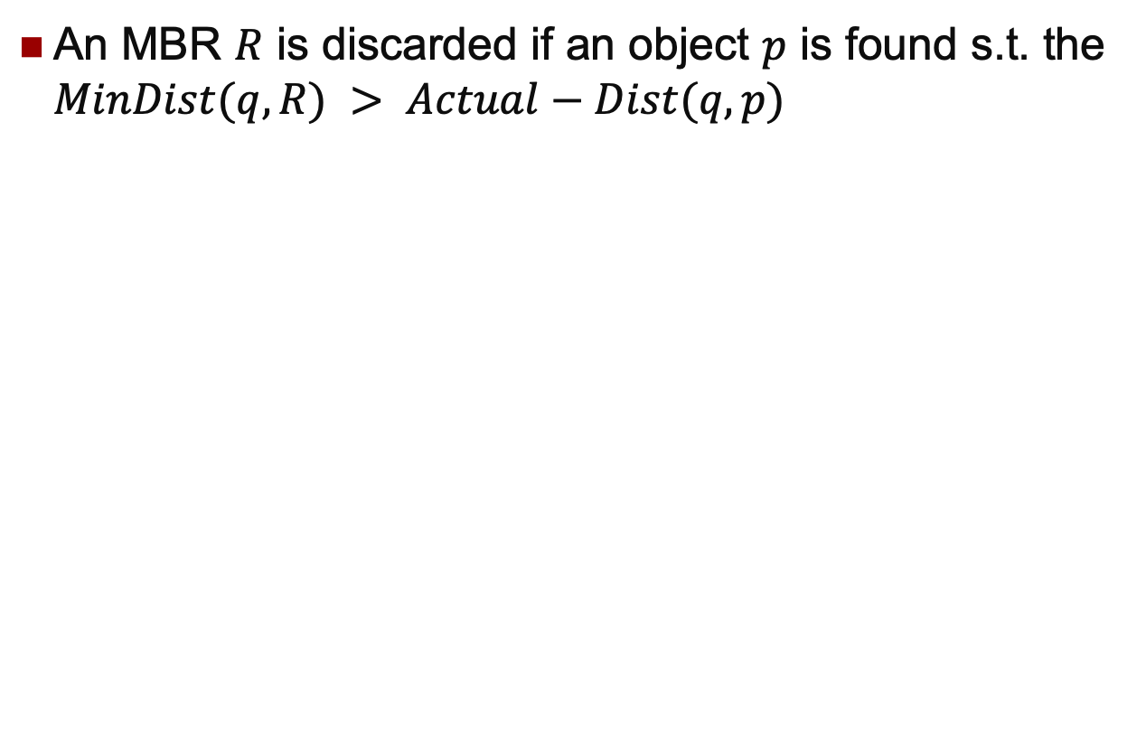
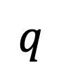
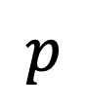
Pruning 3 Example
An MBR $R$ is discarded if an object $p$ is found s.t. the $MinDist(q, R) > Actual−Dist(q, p)$
$$R$$
$$q$$
$$MinDist$$
$$Actual−Dist$$
$$p$$

Slide 14
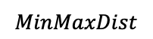
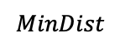
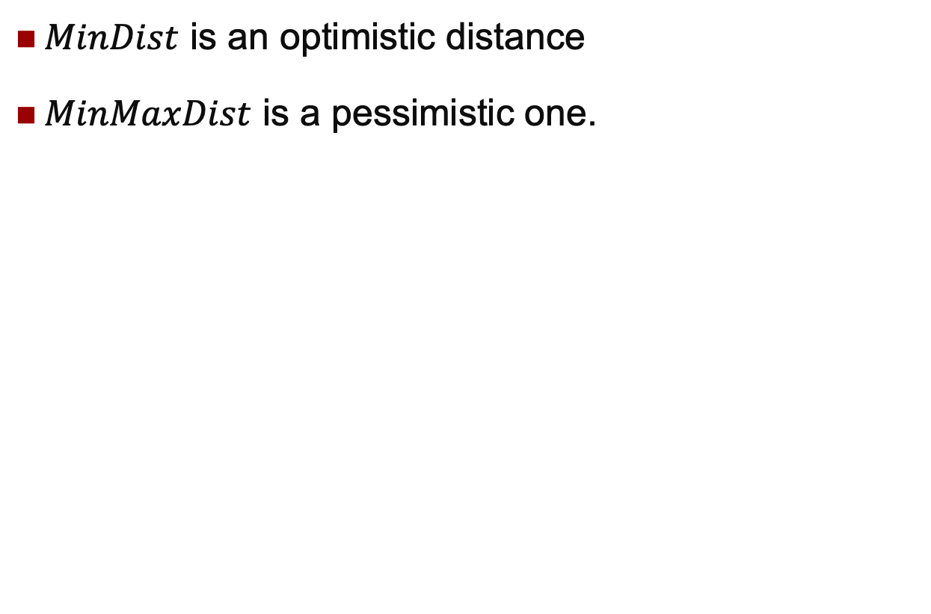
Ordering Distance
$MinDist$ is an optimistic distance
$MinMaxDist$ is a pessimistic one.
$$MinDist$$
q
$$MinMaxDist$$
Which one is better? When to use them? Tutorial~

Slide 15
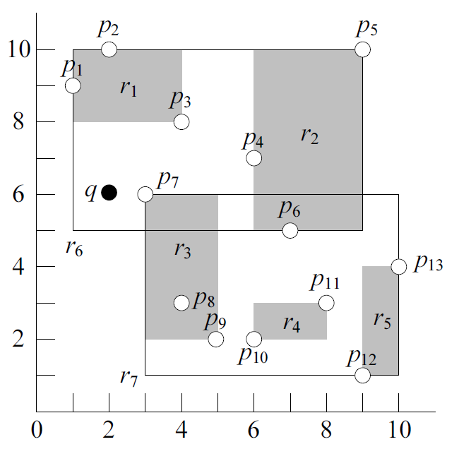
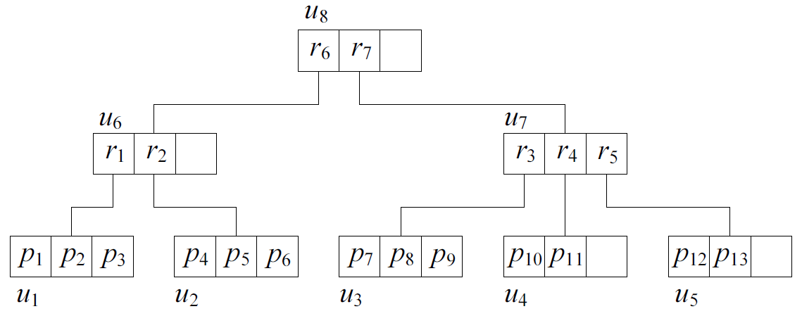
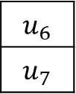
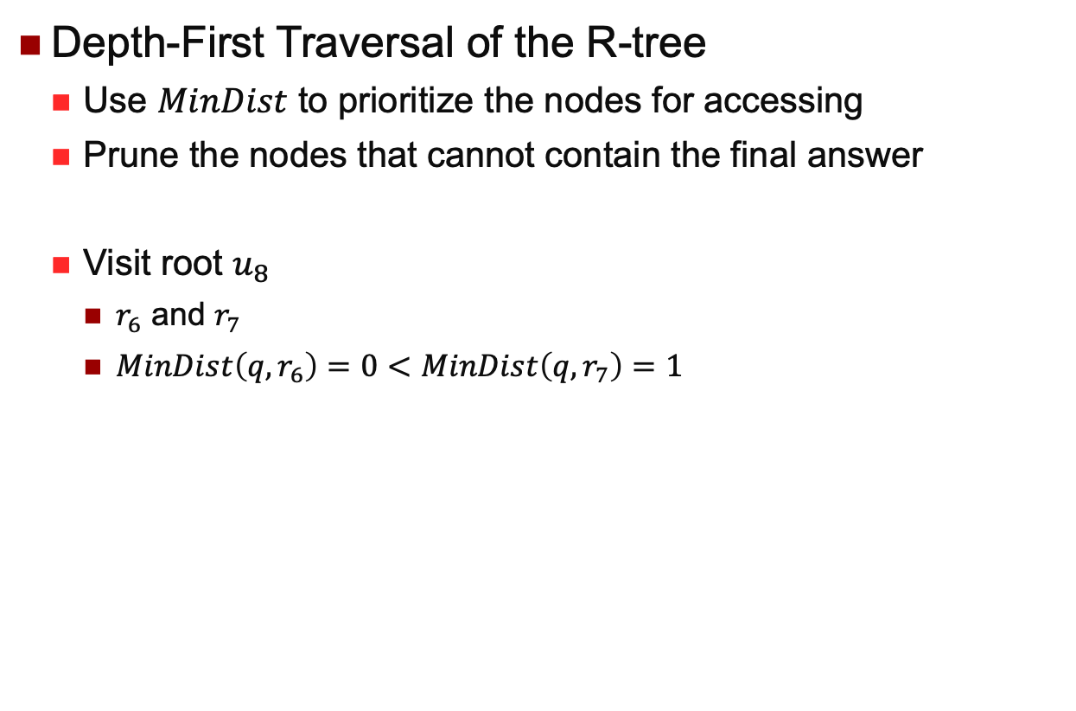
kNN Branch-and-Bound (BaB)
Depth-First Traversal of the R-tree
Use $MinDist$ to prioritize the nodes for accessing
Prune the nodes that cannot contain the final answer
Visit root $u_{8}$
$r_{6}$ and $r_{7}$
$MinDist\left(q,r_{6}\right)=0<MinDist\left(q,r_{7}\right)=1$
$$u_{6}$$
$$u_{7}$$

Slide 16
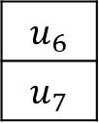
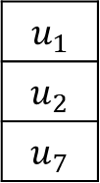
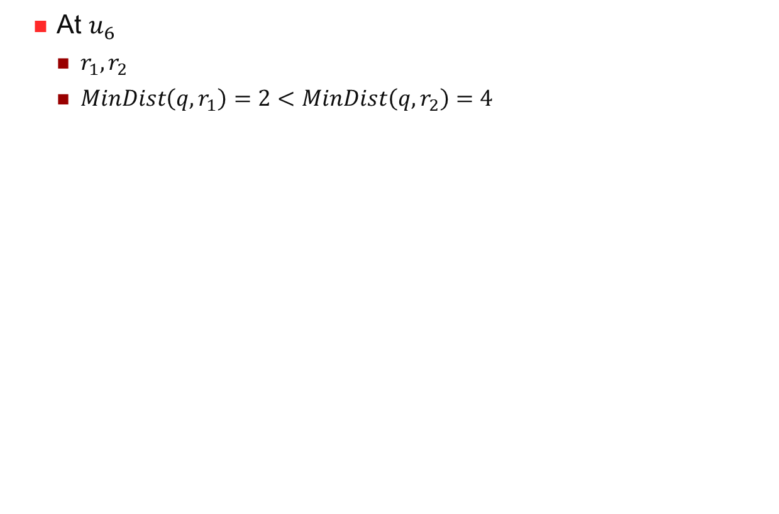
kNN Branch-and-Bound (BaB)
At $u_{6}$
$r_{1}, r_{2}$
$MinDist\left(q,r_{1}\right)=2<MinDist\left(q,r_{2}\right)=4$
$$u_{6}$$
$$u_{7}$$
$$u_{1}$$
$$u_{2}$$
$$u_{7}$$

Slide 17
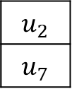
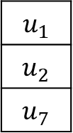
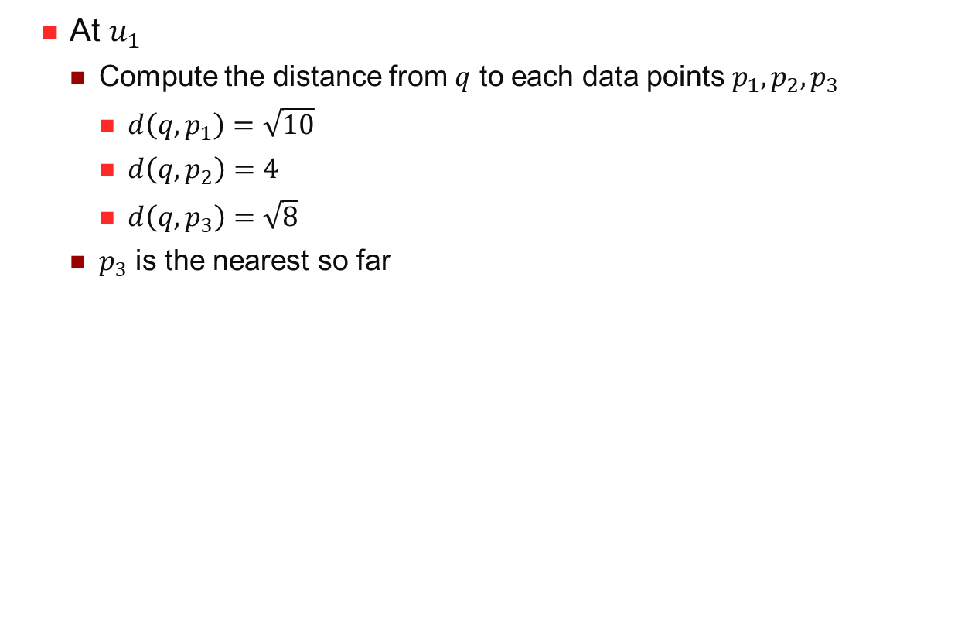
kNN Branch-and-Bound (BaB)
At $u_{1}$
Compute the distance from $q$ to each data points $p_{1},p_{2},p_{3}$
$d\left(q,p_{1}\right)=\sqrt{10}$
$d\left(q,p_{2}\right)=4$
$d\left(q,p_{3}\right)=\sqrt{8}$
$p_{3}$ is the nearest so far
$$u_{1}$$
$$u_{2}$$
$$u_{7}$$
$$u_{2}$$
$$u_{7}$$

Slide 18
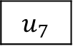
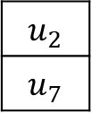
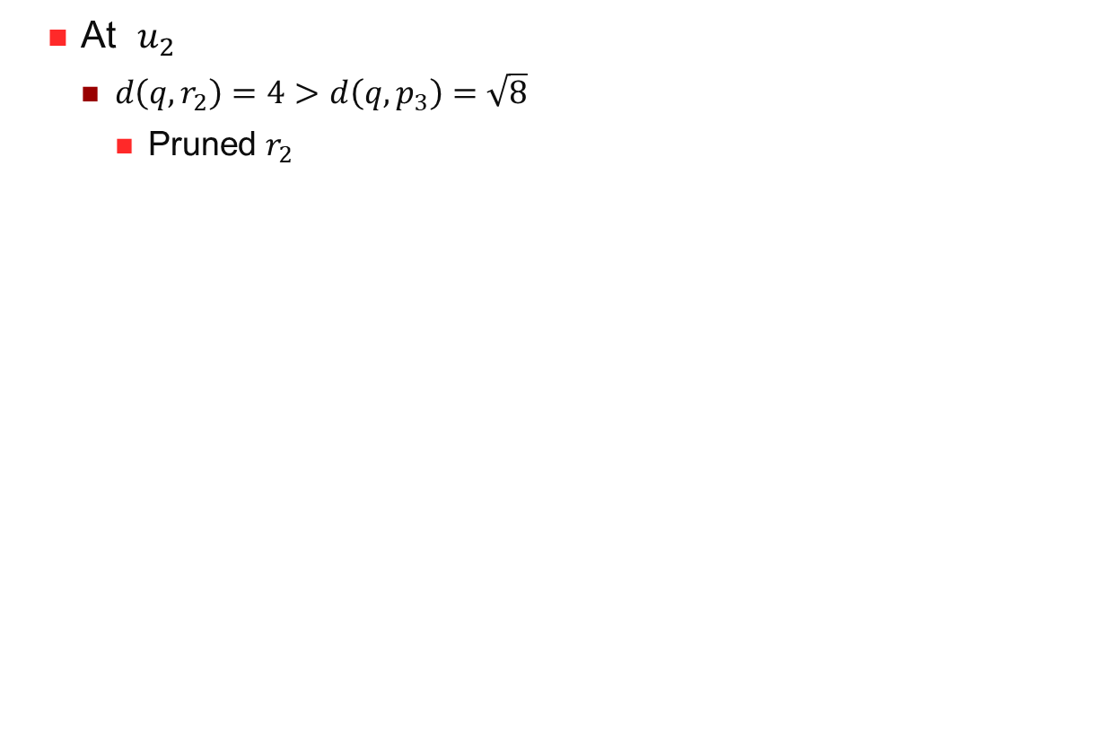
kNN Branch-and-Bound (BaB)
At $u_{2}$
$d\left(q,r_{2}\right)=4>d\left(q,p_{3}\right)=$ $\sqrt{8}$
Pruned $r_{2}$
$$u_{2}$$
$$u_{7}$$
$$u_{7}$$

Slide 19
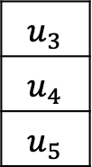
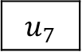
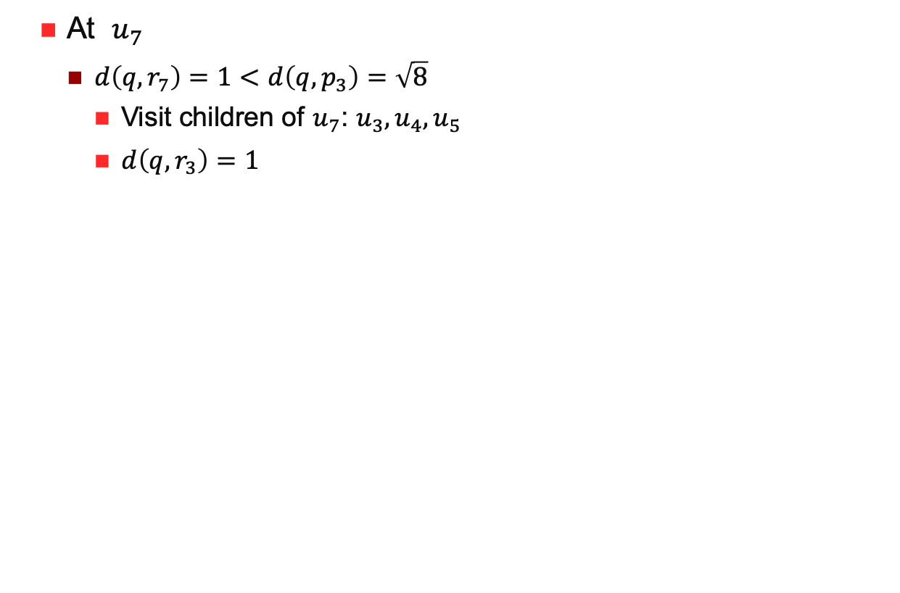
kNN Branch-and-Bound (BaB)
At $u_{7}$
$d\left(q,r_{7}\right)=1<d\left(q,p_{3}\right)=$ $\sqrt{8}$
Visit children of $u_{7}$: $u_{3},u_{4},u_{5}$
$d\left(q,r_{3}\right)=1$
$$u_{7}$$
$$u_{3}$$
$$u_{4}$$
$$u_{5}$$

Slide 20
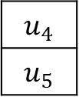
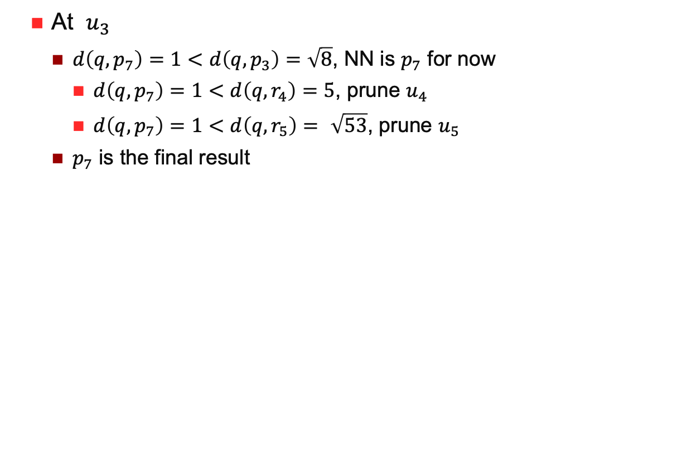
kNN Branch-and-Bound (BaB)
At $u_{3}$
$d\left(q,p_{7}\right)=1<d\left(q,p_{3}\right)=$ $\sqrt{8}$, NN is $p_{7}$ for now
$d\left(q,p_{7}\right)=1$ $<d\left(q,r_{4}\right)=5$, prune $u_{4}$
$d\left(q,p_{7}\right)=1$ $<d\left(q,r_{5}\right)= \sqrt{53}$, prune $u_{5}$
$p_{7}$ is the final result
$$u_{4}$$
$$u_{5}$$

Slide 21
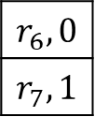
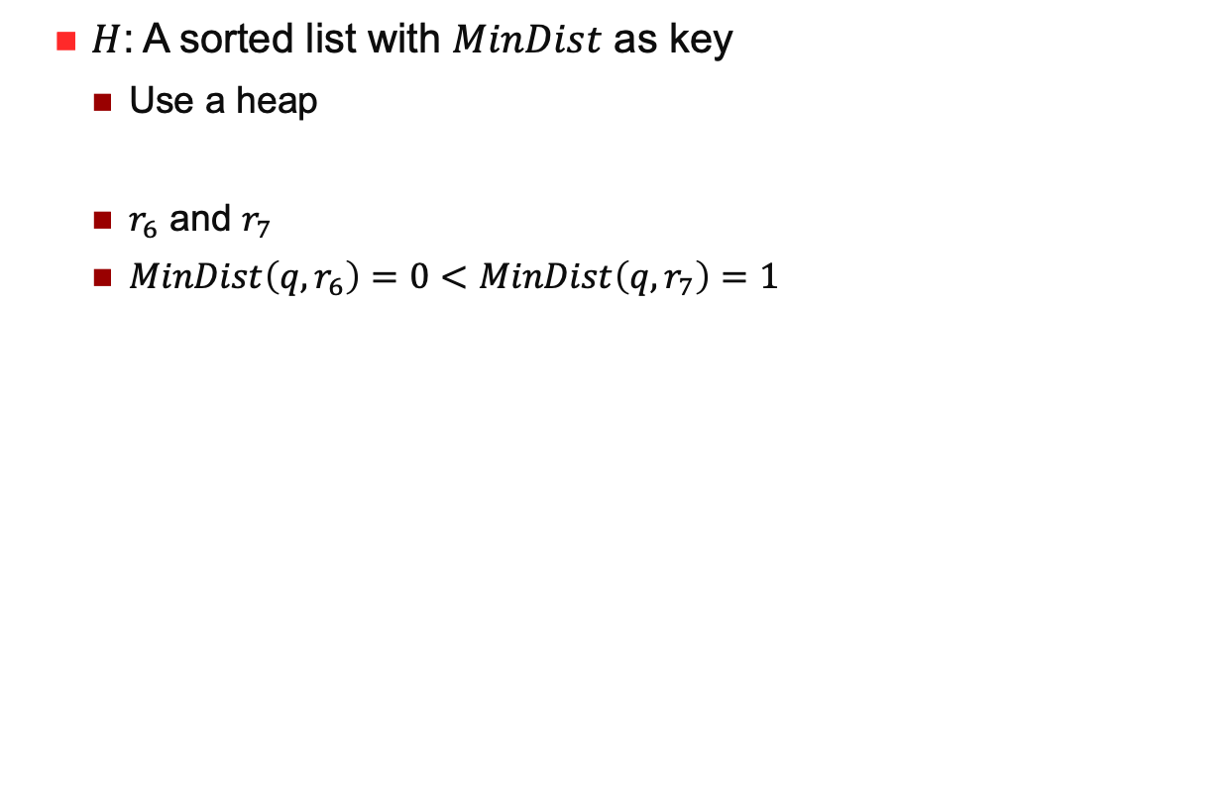
kNN Best First (BF)
$H$: A sorted list with $MinDist$ as key
Use a heap
$r_{6}$ and $r_{7}$
$MinDist\left(q,r_{6}\right)=0<MinDist\left(q,r_{7}\right)=1$
$$r_{6},0$$
$$r_{7},1$$

Slide 22
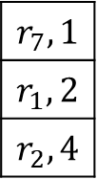

kNN Best First (BF)
Visit $u_{6}$
$r_{1}$ and $r_{2}$
$MinDist\left(q,r_{1}\right)=2$
$MinDist\left(q,r_{2}\right)=4$
$$r_{6},0$$
$$r_{7},1$$
$$r_{7},1$$
$$r_{1},2$$
$$r_{2},4$$

Slide 23



kNN Best First (BF)
Visit $u_{7}$
$r_{3},r_{4}$ and $r_{5}$
$d\left(q,r_{3}\right)=1$
$d\left(q,r_{4}\right)=5$
$d\left(q,r_{5}\right)=$ $\sqrt{53}$
$$r_{7},1$$
$$r_{1},2$$
$$r_{2},4$$
$$r_{3},1$$
$$r_{1},2$$
$$r_{2},4$$
$$r_{4},5$$
$$r_{5},\sqrt{53}$$

Slide 24



kNN Best First (BF)
Visit $u_{3}$
$p_{7},p_{8}$ and $p_{9}$
$d\left(q,p_{7} \right)=1$
$d\left(q,p_{8}\right)=\sqrt{13}$
$d\left(q,p_{9}\right)=$ $5$
1<2, $p_{7}$ is the nearest neighbour
$$r_{3},1$$
$$r_{1},2$$
$$r_{2},4$$
$$r_{4},5$$
$$r_{5},\sqrt{53}$$
$$r_{1},2$$
$$r_{2},4$$
$$r_{4},5$$
$$r_{5},\sqrt{53}$$

Slide 25


Optimality of BF
$C$: A circle centers at $q,$ with radius $d(q,p^{∗})$
$p^{∗}$ is an arbitrary NN of $q$
$S^{∗}:$ All the nodes whose MBRs intersect $C$
All the algorithm must access all the nodes in $S^{∗}$
Assume, for example, that the node with MBR$r$in the ﬁgure below was not accessed. How could the algorithm assert that no point in $r$ is closer to $q$ than $p^{∗}$ ?

Slide 26

Optimality of BF
$BF$ accesses only those nodes whose MBRs intersect $C$
BF accesses MBRs in non-decreasing order of their $MinDist$ to $q$
Let $r_{1}$ and $r_{2}$ be two MBRs accessed consecutively
$r_{2}$ either already existed in $H$ when $r_{1}$ was visited, or$r_{2}$ is an MBR inside $r_{1}$
In either case, it must hold $MinDist\left(q,r_{2}\right)≥MinDist(q,r_{1})$
Let $r$ be the MBR of a leaf node containing an arbitrary NN of $q, r′$ be an MBR that does not intersect $C$
$r$ is visited before $r′$
When $r$ is found, BF must necessarily discover $p^{∗}$
Won’t access $r′$

Slide 27

K-NN search
Just a simple extension
Keep the sorted buffer of at most $k$ current nearest neighbors
Pruning is done using the $k$-th distance

Slide 28


K-NN Query Processing
Many variations
kNN
Find $k$ nearest neighbours
Distance ranking
Browse points by their distances to the query point
Constrained space
Distance is calculated using environment data, such as terrain surface, road networks
Constraint keyword
With labels
$k$ furthest neighbours
Away from rubbish dump
Reverse kNN
For asymmetric relations
Aggregate kNN
Distance sum to a group of points
Continuous kNN
When query point is moving
…

Slide 29







Reverse-NN search
Nearest neighbors need not be symmetric
Nearest neighbor is indicated by the arrow
NN of $q$ is p
NN of $p$ is $r$
NN of $r$ is $s$
NN of $t$ is $r$
NN of $s$ is $r$
Applications
Business Location Planning
How many customers are nearer to me than to my competitors?
Profile-based Marketing
How many new users will regard the new plan as the best match?
Outlier Detection
Point without an RNN might be an outlier
$$p$$
`
$$s$$
$$q$$
$$r$$
`
`
$$t$$
`

Slide 30

Reverse-NN search
Monochromatic
All the points belong to the same set
$RNN\left(q\right)=\left\{r∈S \right| ∀p∈S: d\left(r,q\right)≤d(r,p)\}$
Result has at most 6 points
Space is divided into six equal regions
There exists at most 2 RNN points in each region
If one region has exactly two RNN points, then each of them must be on one of the space dividing lines
Bichromatic
Points belong to one of two sets: $R$ or $B$
Customers and Restaurant
$RNN\left(q\right)=\left\{r∈R \right| ∀p∈B: d\left(r,q\right)≤d(r,p)\}$
Find all the red points whose distance to $q$ are shorter to any blue points
Result size is unbounded

Slide 31


Reverse-NN search
RNN-Tree
Pre-computed all NN results of all the points
One disk of each point
Center at $p,$ radius of $p$ to its NN
All points falling into my disk is my nearest neighbor
RNN query becomes a point query
All the disks cover $q$ are the results
Use R-Tree to organize these disks

Slide 32


Reverse-NN search
Space Dividing
Divide the space into six equal-degree regions $S_{1}$ to $S_{6}$
$p$ is the NN of $q$ in some region $S_{i}$
Either $p∈RNN(q)$ or there is no RNN of $q$ in $S_{i}$
$S_{1}:$ NN of $q$ is $p_{2}$, but $p_{2}$’s NN is $p_{1}$, so prune search in $S_{1}$
Also prune $S_{2},S_{3},S_{4}$, and $S_{6}$
$S_{5}:$NN of $q$ is $p_{6}$, and $p_{6}$’s NN is $q$, so $RNN(q) = \{p_{6}\}$
Two Steps
Find the candidates in six regions
Refine

Slide 33




Keyword-based KNN
Text Description + Location
Boolean Range Query
Retrieve objects containing all the query keywords and in the query region
Boolean kNN Query
Ranked according to their distance
Top-k kNN Query
$α∙ Dist\left(q,o\right)+\left(1−α\right)∙TRel\left(q,o\right)$

Slide 34





Keyword-based KNN
Text First
Spatial First
Combination

Slide 35



KNN in Road Network
Graph $G=(V,E)$
Distance computing in road networks is costly
Shortest path: Dijkstra’s algorithm and $A^{∗}$ algorithm
Euclidean distance for approximation
Optimization focus is different
Not only the number of points to be accessed
But also the network data to be accessed

Slide 36

Skyline Queries
Which buildings can you see?

Slide 37

Monotonically Increasing Functions
Monotonically Increasing Functions
Let $p$ be a $d$-dimensional point in $ℝ^{d}$
Let $f$ : $ℝ^{d}→R$ a function that calculates a score $f(p)$ for $p$
We say that $f$ is monotonically increasing if the score increases when any coordinate of $p$ increases.

Slide 38



Multi-Criteria Optimization
Top-1 Search
Let $P$ be a set of $d$-dimensional points in $ℝ^{d}$ . Given a monotonically increasing function $f$ , a top-1 query finds the point in $P$ that has the smallest score
$f$ is often referred to as the preference function of the query
If $f\left(x,y\right)=x+y,$ the top-1 point is $p_{8}$
Applications
Find the hotel that minimizes price + distance (to the beach)
Find the second-handed car that minimizes price + 0.1$×$mileage
Find the interviewee that maximizes 0.4$×$education + 0.4$×$experience + 0.2$×$personality
...

Slide 39


Top-1 Search
Top-1 Search in NN
The NN of the origin of the data space according to the distance function $f$
What is the $MinDist$ of an MBR to the query point?

Slide 40

Top-1 Search
Drawback
It is difficult to decide which preference function $f$ to use
Why is $f\left(x,y\right)=x+y$ a good function?
Why not $2x+y?$
Why not $\sqrt{x}+y^{2}?$
Why not drop the preference function?
How do we return the top-1 point?
Skyline Operator
Return a small set of objects that is guaranteed to cover the result of any top-1 query
Regardless of the preference function

Slide 41
Finding a Hotel…
distance
t₂, t₃ and t₄ are dominated.
t₂
t₄
t₃
t₇
1 2 3 4 5 6 7 8
t₅
t₁
t₆
1 2 3 4 5 6 7 8 9
price
Skyline query: retrieve all points that are not dominated

Slide 42
Skyline Query Applications
Find best NBA players
(#points, #rebounds), or any other subset of the 17 dimensions.
Find best laptops
(price, screen size, weight, battery, memory size, disk size, CPU speed, warranty…)
Any table in a RDBMS has a list of records with multiple attributes, so ……

Slide 43

A Formal Definition
Assume the preference is smaller (e.g., closer to beach, cheaper hotel etc) – other semantics can be supported too
For two $d$-dimensional points $p$ and $q, p$dominates $q$ iff
(1) $∀1 ≤ i ≤ d, p_{i} ≤ q_{i}$ and
(2) $∃1 ≤ i ≤ d, p_{i} < q_{i}$
Informally, a point dominates another point if it is as good or better in all dimensions and better in at least one dimension
Dominance is transitive
A skyline query is to find all points from a dataset which are not dominated by any other points in the dataset
…Pareto dominance

Slide 44

Skyline For Top-1
For any monotonically increasing function $f$, a top-1 point is definitely in the skyline
Proof
Suppose it is not true, and there exists a function $f$ for which a top-1 point $p$ is not in the skyline
$p$ is dominated by at least another point $p′$
$f$ is monotonic, so $f\left(p^{′}\right)<f\left(p\right)$
Contradicts that $p$ is the top-1 point
Every point in the skyline is definitely a top-1 point of some monotonically increasing function

Slide 45

Skyline Block Nested Loop
Basic Idea
Compare each point $p$ with every other point
If $p$ is not dominated, then it is part of the skyline
$O(n^{2})$
BNL (Block Nested Loop)
Keeps a list of candidate skyline points in memory
If $p$ is dominated by any point in the list, discard it
If $p$ dominates any point in the list, insert $p$ in the list and discard all the points dominated by $p$ in the list
If $p$ is neither dominated, nor dominates, any point point in the list, insert $p$ to the list
Heuristic
When a point in list dominates $p,$ move this point to the head of the candidate list

Slide 46


Skyline Divide and Conquer
Basic Idea
Divide the dataset into several partitions so that each partition fits in memory
Compute partial skyline of the points each partition with the previous BNL
Merge the partial results
All points in the skyline of $s_{3}$ must appear in the final skyline
If $s_{3}$ is not empty, discard all result of $s_{2}$ directly
$s_{1}$ and $s_{4}$ only needs to compare with $s_{3}$
Disadvantages
Only efficient for small dataset
Large IO for big dataset
Not suitable for online processing
Only report result when finish

Slide 47


Skyline Dominance Screening
Also Divide and Conquer
$O(nlog n)$
Let $P$ and $Q$ be sets of $d$-dimensional points in $ℝ^{d}$
The objective of the dominance screening problem is to report all the points in $q∈Q$ such that $q$ is not dominated by any points in $P$
Suppose $P$ is the set of white points, $Q$ is the set of red points
The answer is $\{p_{8},p_{9},p_{6},p_{10}\}$

Slide 48

1D Dominance Screening
$P$ is the set of white, $Q$ is the set of red
The answer is $\{p_{1},p_{2},p_{3}\}$
Identify the leftmost point $p_{min}$in $P$
Report every point $q∈Q$ such that $q≤p_{min}$
$O(n)$

Slide 49


2D Dominance Screening
Divide and Conquer
Divide the input set into two halves by $x$-coordinate
$P_{1}/Q_{1}$ be the white/red points on the left
$P_{2}/Q_{2}$ be the white/red points on the right
Two instances of the dominance screen problem
Solve them individually
Left: $p_{8}, p_{9}$
Right: $p_{5}, p_{6}, p_{10}$
Merge the results
Left results are definitely in the final answer
Right: if and only if no white point from left dominates it

Slide 50


2D Dominance Screening
Divide and Conquer
Reduce the right problem to the 1D dominance screening
$A_{right}:$ the answer of the right
$P^{′}:$ the projections of $P_{1}$ onto the $y$-axis
$Q^{′}:$ the projection of $A_{right}$ onto the $y$-axis
$P^{′}=\left\{p_{7},p_{1},p_{2}\right\} Q^{′}=\left\{p_{10},p_{6},p_{5}\right\}$
Result is $\{p_{6},p_{10}\}$

Slide 51

2D Dominance Screening
Time complexity
$f\left(n\right)≤2∙f\left(\frac{n}{2}\right)+O(n)$
$f\left(\frac{n}{2}\right):$ cost of solving the left and right instances
$O(n)$: load, divide, 1D dominance screening
$f\left(n\right)=O(nlog n)$
$d$-dimensional space?
Reduce to $d−1$ dimensional space
$f\left(n\right)≤2∙f\left(\frac{n}{2}\right)+g(n)$
$g\left(n\right):$ cost of solving the problem in the $d−1$ dimensional space
$f\left(n\right)=O(nlog^{d−1} n)$

Slide 52


Skyline in d-Dimensional Space
Use dominance screening to merge the solutions of two subproblems
$P_{1}$: the set of points on the left half
$P_{1}=\{p_{1},p_{2},p_{3},p_{7},p_{8},p_{9}\}$
$P_{2}:$ the set of points on the right half

Slide 53


Skyline in d-Dimensional Space
$A_{left}=\{p_{1}, p_{8},p_{9}\}$
Must be in the final skyline
$A_{right}=\{p_{5}, p_{6},p_{10},p_{12}\}$
If and only if no point from $A_{left}$ dominates it
Reduce the problem to 1D dominance screening
$P^{′}:$ the projections of $A_{left}$ onto the $y$-axis
$Q^{′}:$ the projection of $A_{right}$ onto the $y$-axis
$2D: O(nlog n)$
$d$-dimensional: $O(nlog^{d−1} n)$

Slide 54


Skyline with Bitmap
Convert values to the bitmap
10 values
1 is the smallest 11111 11111
10 is the largest 10000 00000
Each 2D point is converted to a pair of bitmaps
Significant bit: The right most 1
$c\left(4,8\right):$ $4^{th}$ bit of $x,$ $8^{th}$ bit of $y$

Slide 55

Skyline with Bitmap
Skyline Finding
$c\left(4,8\right), 4^{th}$ bit of $x$, $8^{th}$ bit of $y$
Retrieve all the $4^{th}$ bits from top to bottom of $x$ $c_{x}=$11100 00110 000
Retrieve all the $8^{th}$ bits from top to bottom of $y$ $c_{y}=$ 00110 11111 111
The 1s are the points that have smaller values at each dimension
Take $c_{x} \& c_{y}$ : 00100 001100 000
1 means point $c$ is dominated by these points ($c, h,i$)

Slide 56

Skyline with NN
Let $p$ be the (Euclidean) NN of the origin of the data space, among all the points in the dataset $P$. Then, $p$ must be in the skyline of $P$
Proof
Suppose it is not true, then $p$ is dominated by at least another point $p′$
This, however, means that $p^{′}$must be closer to the origin than $p$
Contradict
Use NN as a Black Box
Repeat the following operations until R-tree is empty
Find the NN $p$ of the origin of the data space. Include $p$ into the skyline
Delete $p$ from the tree, as well as all the points that are dominated by $p$

Slide 57


Skyline with NN Example
The first NN query finds $p_{8}$
The figure on the right shows the dataset after the corresponding deletions

Slide 58


Skyline with NN Example
The second NN query finds $p_{9}$
The figure on the right shows the dataset after the corresponding deletions

Slide 59


Skyline with NN Example
The third NN query finds $p_{1}$ and $p_{12}$
The dataset becomes empty after corresponding deletions
Final skyline points=$\{p_{8},p_{9},p_{1},p_{12}\}$

Slide 60

Branch and Bound Skyline (BBS)
The previous algorithm must access all the points
BBS
A variation of the BF algorithm
It accesses the nodes of the R-tree in ascending order of their $MinDist$s from the origin
Different from NN search
Once MBR in its entirely is dominated by a skyline point already found, it can be pruned

Slide 61

Branch and Bound Skyline (BBS)
Access the root, put the MBRs in a sorted list
$$r_{7},\sqrt{10}$$
$$r_{6},\sqrt{26}$$

Slide 62


Branch and Bound Skyline (BBS)
Visit $u_{7}$
Insert $r_{3}, r_{4},r_{5}$ into the heap
$$r_{3},\sqrt{13}$$
$$r_{6},\sqrt{26}$$
$$r_{4},\sqrt{40}$$
$$r_{5},\sqrt{82}$$

Slide 63



Branch and Bound Skyline (BBS)
Visit $u_{3}$
Insert all its point into the list
$$r_{3},\sqrt{13}$$
$$r_{6},\sqrt{26}$$
$$r_{4},\sqrt{40}$$
$$r_{5},\sqrt{82}$$
$$p_{8},\sqrt{18}$$
$$r_{6},\sqrt{26}$$
$$p_{9},\sqrt{29}$$
$$r_{4},\sqrt{40}$$
$$p_{7},\sqrt{45}$$
$$r_{5},\sqrt{82}$$

Slide 64



Branch and Bound Skyline (BBS)
Remove $p_{8}$ from the list
This is the first skyline point found
$$p_{8},\sqrt{18}$$
$$r_{6},\sqrt{26}$$
$$p_{9},\sqrt{29}$$
$$r_{4},\sqrt{40}$$
$$p_{7},\sqrt{45}$$
$$r_{5},\sqrt{82}$$
$$r_{6},\sqrt{26}$$
$$p_{9},\sqrt{29}$$
$$r_{4},\sqrt{40}$$
$$p_{7},\sqrt{45}$$
$$r_{5},\sqrt{82}$$

Slide 65



Branch and Bound Skyline (BBS)
Access $u_{6}$
Insert $r_{1}$ and $r_{2}$ in the list
$$r_{6},\sqrt{26}$$
$$p_{9},\sqrt{29}$$
$$r_{4},\sqrt{40}$$
$$p_{7},\sqrt{45}$$
$$r_{5},\sqrt{82}$$
$$p_{9},\sqrt{29}$$
$$r_{4},\sqrt{40}$$
$$p_{7},\sqrt{45}$$
$$r_{2},\sqrt{61}$$
$$r_{1},\sqrt{65}$$
$$r_{5},\sqrt{82}$$

Slide 66



Branch and Bound Skyline (BBS)
Visit $p_{9}$
Second skyline point
$$p_{9},\sqrt{29}$$
$$r_{4},\sqrt{40}$$
$$p_{7},\sqrt{45}$$
$$r_{2},\sqrt{61}$$
$$r_{1},\sqrt{65}$$
$$r_{5},\sqrt{82}$$
$$r_{4},\sqrt{40}$$
$$p_{7},\sqrt{45}$$
$$r_{2},\sqrt{61}$$
$$r_{1},\sqrt{65}$$
$$r_{5},\sqrt{82}$$

Slide 67



Branch and Bound Skyline (BBS)
$r_{4}$ is discarded
Lower-left corner is dominated by $p_{9}$
No point in $r_{4}$ can possibly be in the skyline
$p_{7}$ and $r_{2}$ are also discarded
$$r_{4},\sqrt{40}$$
$$p_{7},\sqrt{45}$$
$$r_{2},\sqrt{61}$$
$$r_{1},\sqrt{65}$$
$$r_{5},\sqrt{82}$$
$$r_{1},\sqrt{65}$$
$$r_{5},\sqrt{82}$$

Slide 68




Branch and Bound Skyline (BBS)
Access $u_{1}$
$p_{3}$ can be discarded
$p_{1}$ is a skyline
Find the last skyline point $p_{12}$ in $r_{5}$
$$r_{1},\sqrt{65}$$
$$r_{5},\sqrt{82}$$
$$p_{3},\sqrt{80}$$
$$p_{1},\sqrt{82}$$
$$r_{5},\sqrt{82}$$
$$p_{2},\sqrt{104}$$
$$r_{5},\sqrt{82}$$
$$p_{2},\sqrt{104}$$

Slide 69


Optimality of BBS
It accesses the least number of nodes among all the algorithms that correctly finds the skyline using the same R-tree without modifying the structure
Search Region
The union of the points in $ℝ^{d}$ that are not dominated by any skyline point
Any correct algorithm must access all the nodes whose MBRs intersect the search region
BBS accesses only the nodes whose MBRs intersect with the search region

Slide 70

Optimality of BBS
Proof
Assume that the algorithm needs to visit a node $u$ whose MBR $r$ is disjoint with the region
It follows that a skyline point $p$ dominates the lower-left corner of $r$
$p$ has a smaller $MinDist$ than $r$
The sequence of points/nodes processed by BBS is in ascending order of $MinDist$ to the origin
$p$ is processed before $u$
It is impossible to visit $u$

Slide 71
More on Skylines
Variations
Dynamic skyline queries
The distance is to a give query point, not fixed
Skyline in constrained spaces such as road networks
How many they dominate?
K points that dominate the largest number of other points
The result points are not necessarily in the skyline result
Near-skyline points
Top-k skyline (ranked)
Skyline queries with uncertainty
Skyline in high dimensional space
Skyline in partially ordered space
…

Slide 72

kNN vs Skyline
These two types of queries are related in a multidimensional space
If an overall ranking function is available (e.g., distance function, similarity function), then kNN can be used
Otherwise, skyline may be more useful
A skyline query returns a superset of any NN queries (based on any liner combination of the attributes)
$f\left(x, y\right)= w × x + \left(1−w\right)×y$for any weight $w$
This subset can often be very large (too large to be useful)
These two can be used together (e.g., to give a ranked list, and also more contextual information about the recommendation)

Slide 73
Final Words on Spatial Databases
Spatial databases is one of the most successful database innovations since the relational model
Real problems, real solutions, real impacts
Foundation to many other complex data management and similarity query processing
Challenges are still there
…so are the opportunities, for researchers and entrepreneurs
Next…
Spatiotemporal databases (moving objects)
High dimensional data

